Slide 1
Engineering Challenge 2: Bioreactor Proposal presentation
CS-EEE 02
Qiren Dong, Maciej Kowalski, Grace Lau, Nerea Sainz de la Maza Melón, Yujie Peng, Aaryman Sharma, Raven Valencia, Zhiyu Wang, Jian Yang

Slide 2
Context & Specification
Parameter control requirements:
Connectivity requirements:
2-way communication via wi-fi
Setpoints adjustment
Log of all the parameters
Component | Range | Accuracy with respects to the setpoint
temperature control system | 25-35°C | 0.5°C
stirring subsystem | 500-1500 RPM | 20RPM
pH subsystem | 3-7 | 0.5

Slide 3
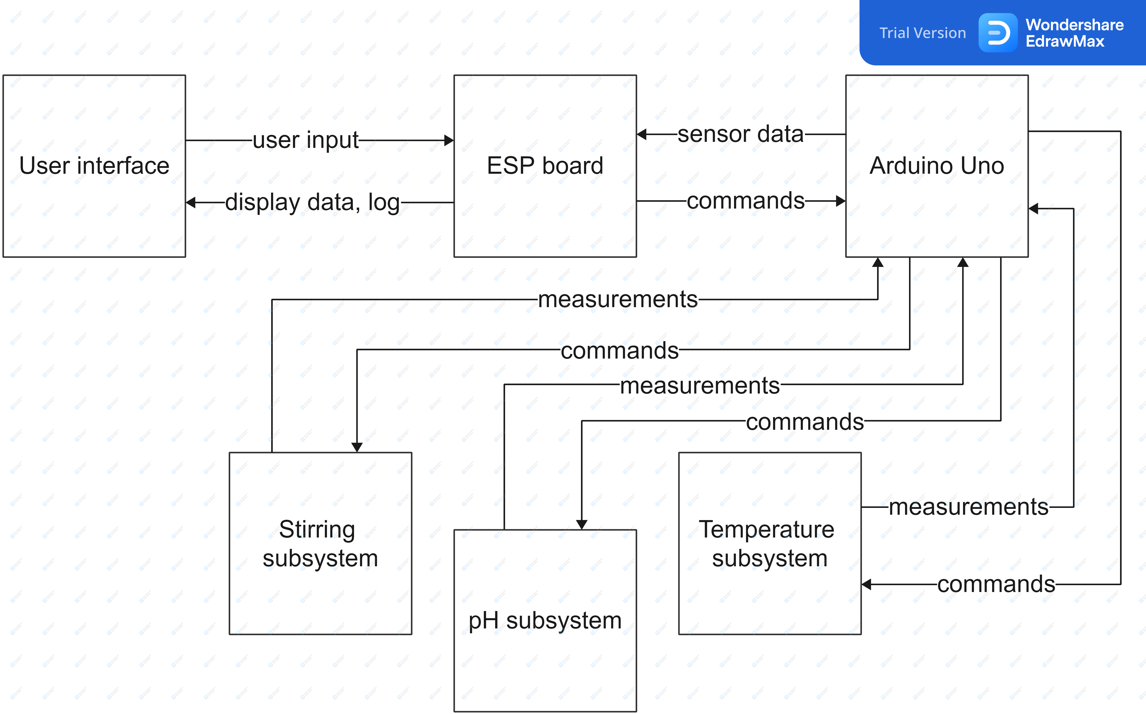
Block diagram of the system

Slide 4
pH subsystem

Slide 5
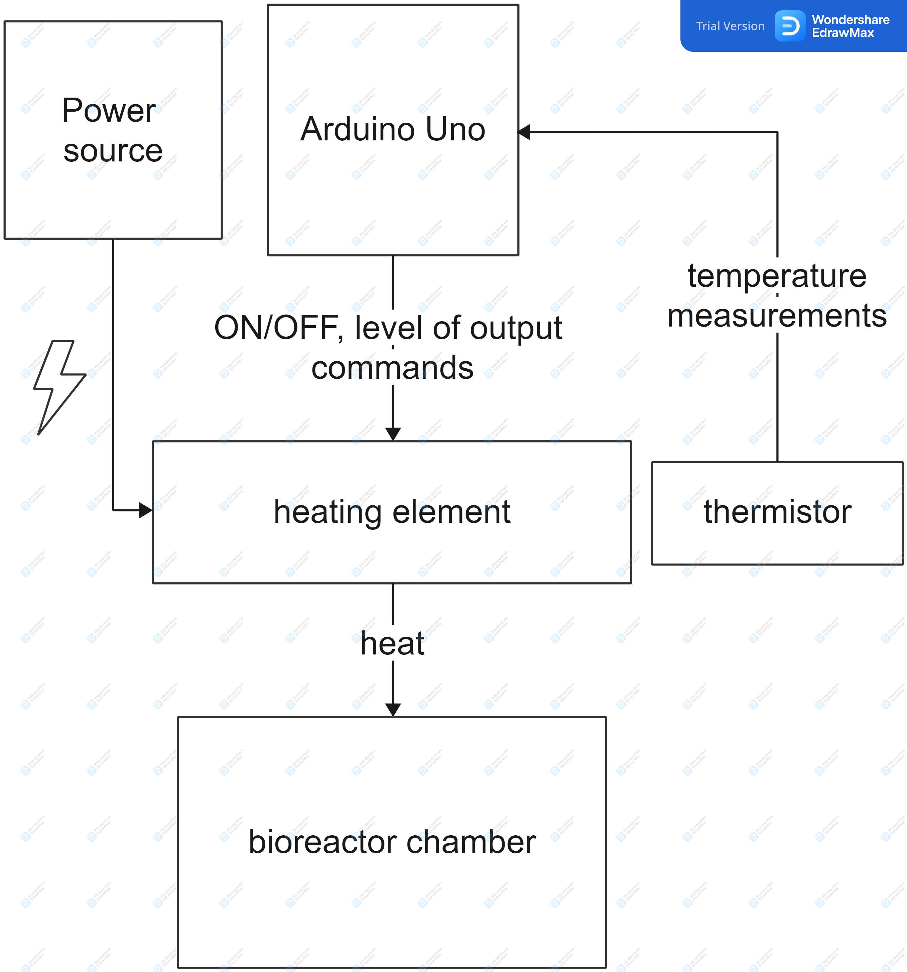
Temperature subsystem

Slide 6
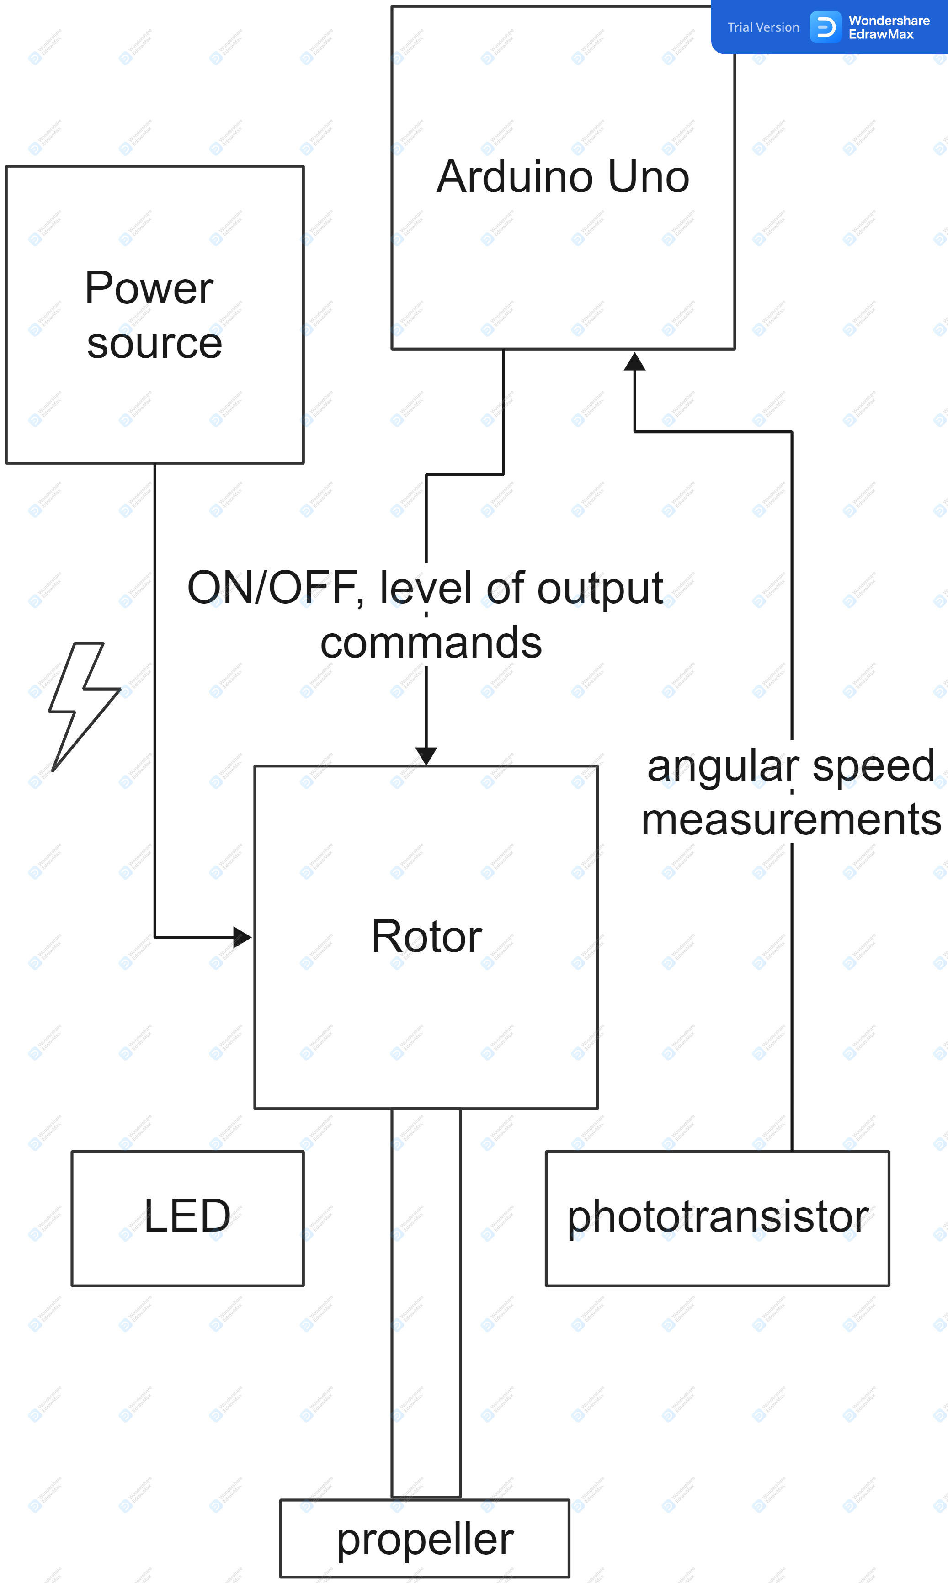
Stirring subsystem

Slide 7
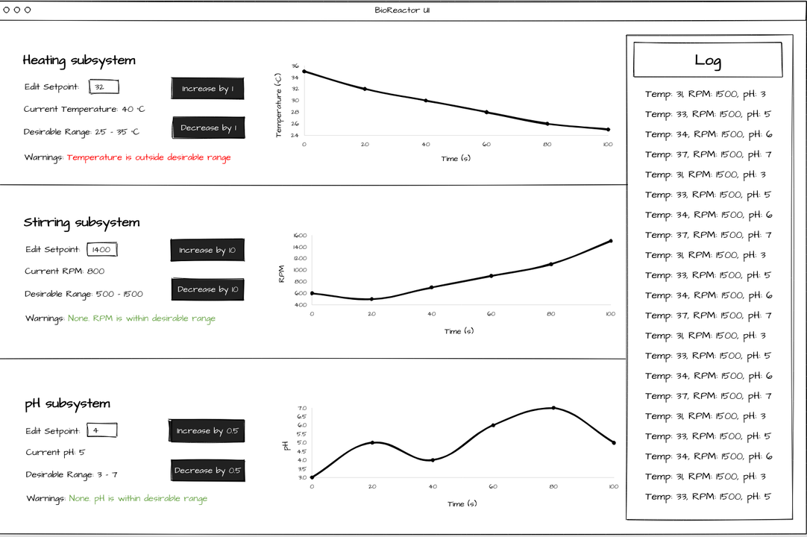

Slide 8
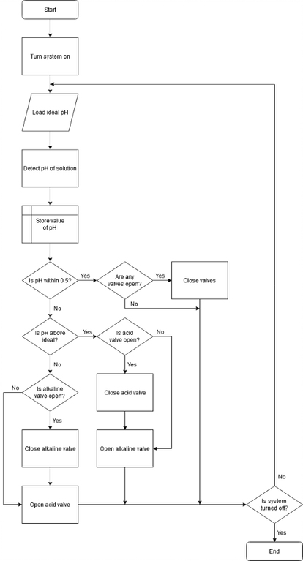
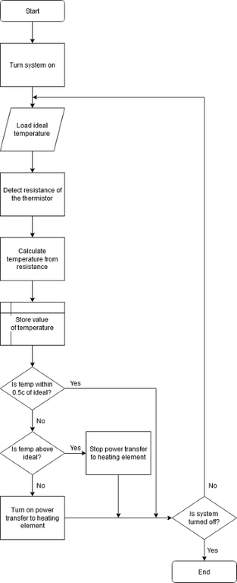
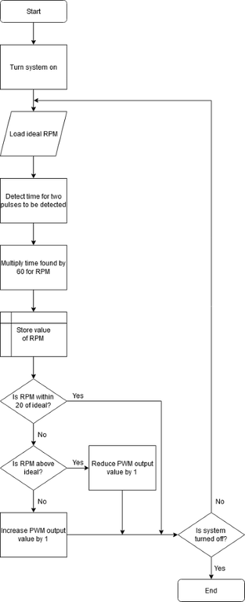

Slide 9
Gantt chart
Tasks | Week
 | 4 | 5 | 6 | 7 | 8 | 9 | 10
Team organisation
Research
Presentation preparation
Design
Building & Programming
Testing & Calibration
System integration
Final testing
System demonstration and report preparation

Slide 10
Team roles
Role | Person
Motion system (lead) | Raven
pH system (lead) | Grace
pH subsystem | Qiren
Temperature subsystem (lead) | Yujie
Temperature subsystem | Jian
Connectivity | Nerea, Aaryaman, Maciej, Zhiyu

Slide 11
Thank you for your attention!

